Slide 1

Multi-agent pathfinding WITH SIMULATED ANNEALING
Nina Dobša, Vittorio Vičević

Slide 2
Agenda
MAPF problem
Simmulated Anealing
Solution code
Results
Conclusion

Slide 3
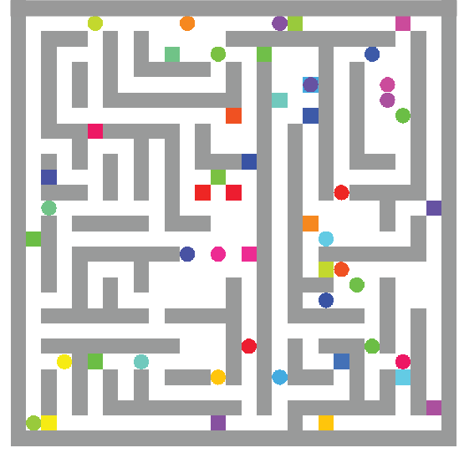
MAPF problem
GOAL : Compute collision-free paths for agents from their start locations to given destinations
CONSTRAINTS:
Each agent can perform one step at a time
Collisions forbidden:
vertex conflict
OBJECTIVE: Minimize Makespan (the number of time steps required for all agents to reach their target)

Slide 4
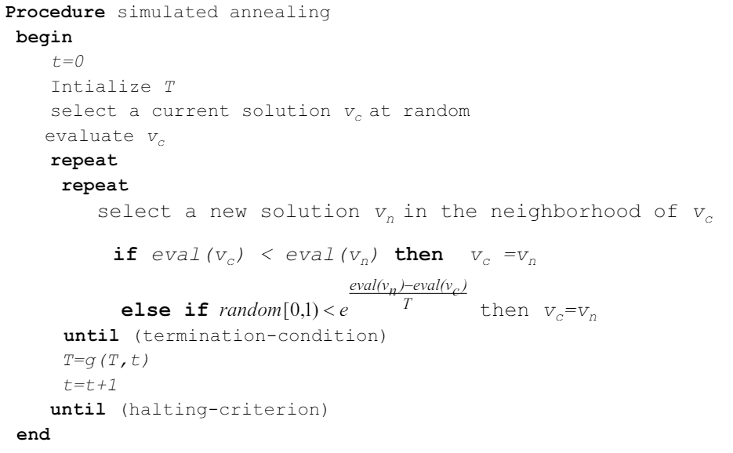
SIMULATED ANNEALING
Changes the parameter T (temperature) during the search
high value of T -> random search
small value of T -> SA behaves like an ordinary Hill-climber

Slide 5
solution code - Variables
Variables:
grid_size
num_agents (33%-67%)
class agent
agent.start = ordered pair Randomly choosen
agent.end = ordered pair
agent.path = array of ordered pairs
max_iter = 200 000
initial_temp = 1 000
cooling_rate = 0.99

Slide 6
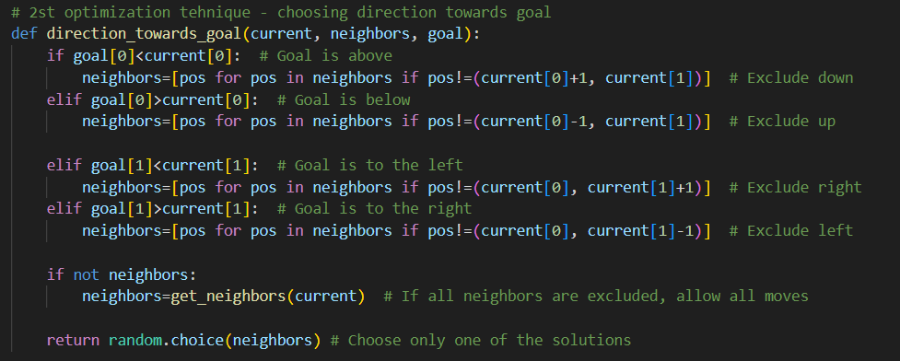
Optimization tehniques
Avoiding visited squares
Choosing direction towards goal
Forcing algorithm to first modify path of agents in collision

Slide 7
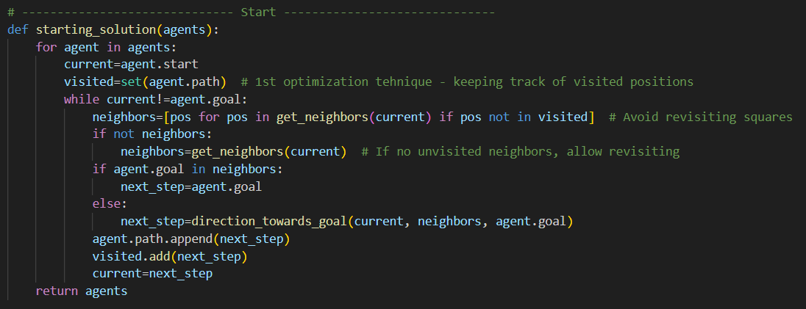
starting solution
Almost random – optimizations 1 and 2 used
Initial solution can contain collisions

Slide 8
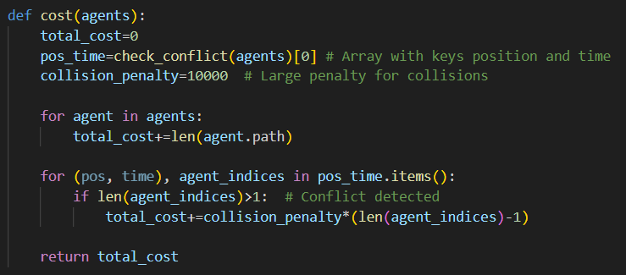
cost function
Cost function = sum of length of paths + collision penalty
pos_time -> array with two keys, position and time

Slide 9
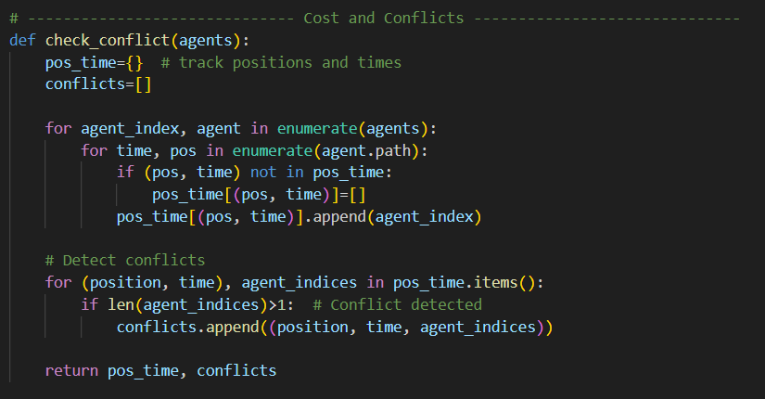
Check conflict
Returns tuple with position, time and agent’s index if there are conflicts (collisions)

Slide 10
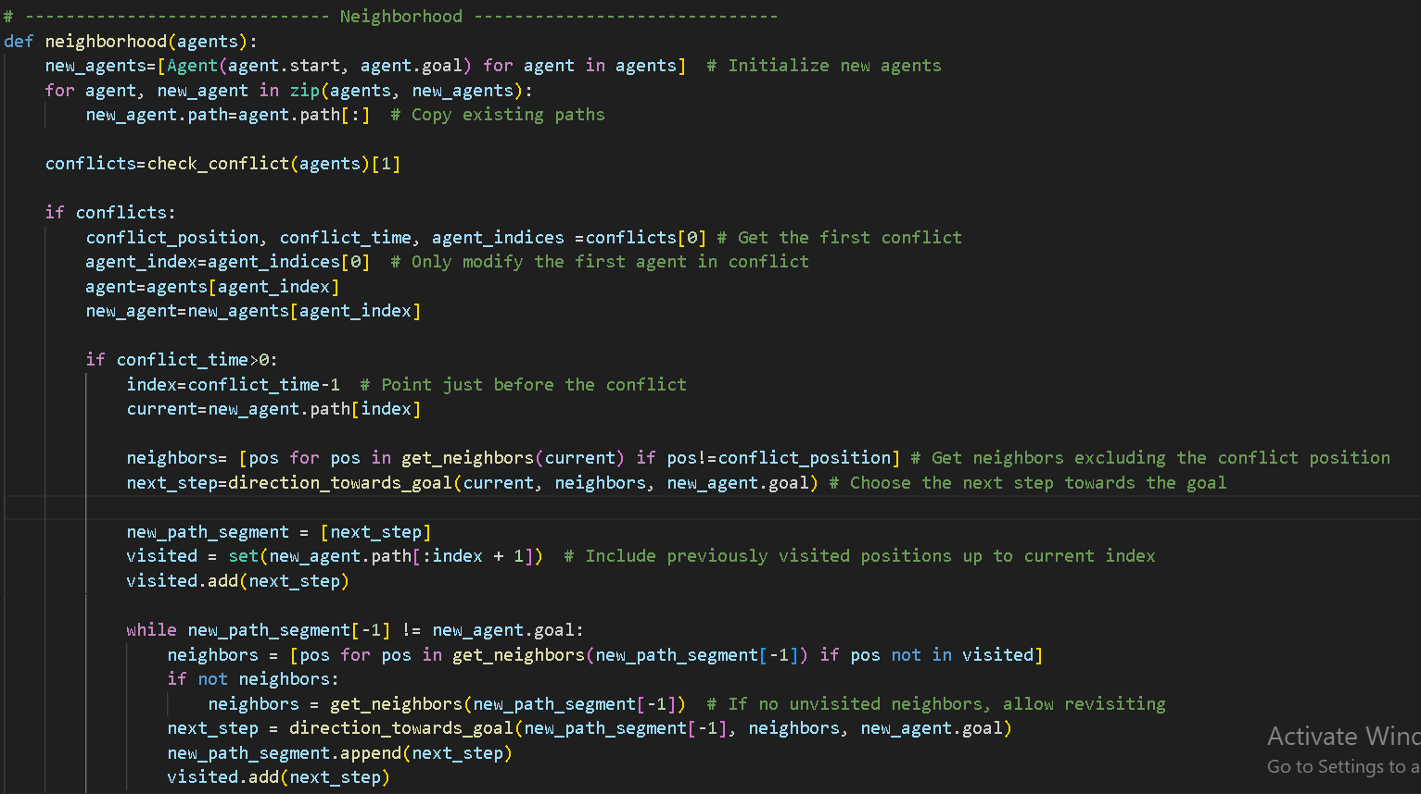
NEIGHBORHOOD
If there are conflicts in a solution
- Find first conflict
- Change path of one agent starting from the point before the conflict

Slide 11
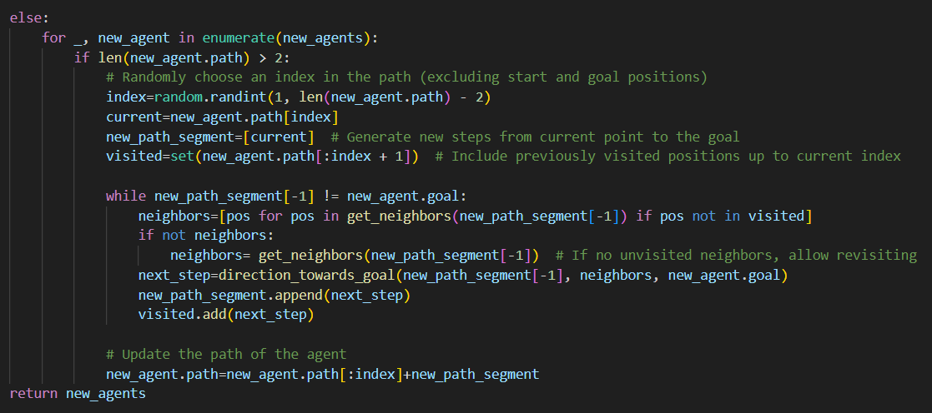
NEIGHBORHOOD
If there are no conflicts in a solution
- Change path for each agent
- Path is changed from a random point on agents path (excluding start and end positions)

Slide 12
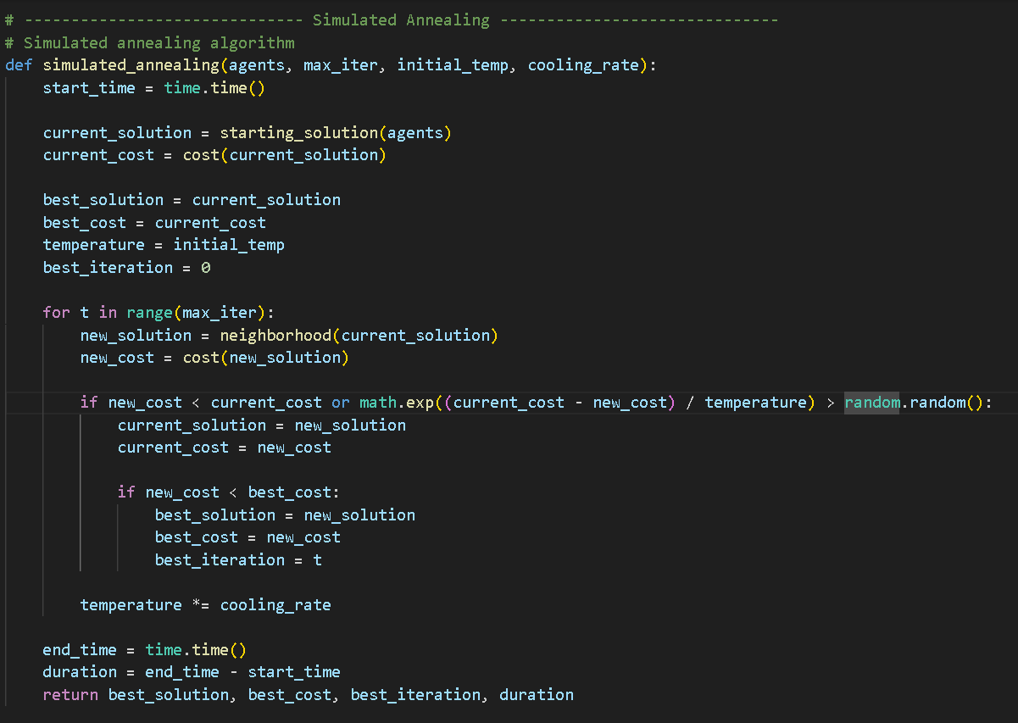
Simulated Annealing algorithm

Slide 13
Results – small grids (N = 10-20)
Running time depends on grid size and number of agents
6* run has temperature = 500 and cooling_rate = 0.95
Test | N | numAgents | Initial Cost | Testing runs | Time (s) | Cost_final
1 | 10 | 5 | 20126 | 1 | 36 | 34
 |  |  |  | 2 | 37 | 34
 |  |  |  | 3 | 38 | 32
 |  |  |  | 4 | 30 | 28
 |  |  |  | 5 | 38 | 34
 |  |  |  | 6* | 31 | 28
Statistics from 5 runs:
Average Cost: 32.4
Best Cost: 28
Standard Deviation: 2.61

Slide 14
Results – small grids (N = 10-20)
Running time depends on grid size and number of agents
6* run has temperature = 500 and cooling_rate = 0.95
Test | N | numAgents | Initial Cost | Testing runs | Time (s) | Cost_final
2 | 15 | 6 | 70212 | 1 | 84 | 74
 |  |  |  | 2 | 86 | 74
 |  |  |  | 3 | 85 | 74
 |  |  |  | 4 | 85 | 76
 |  |  |  | 5 | 87 | 78
 |  |  |  | 6* | 86 | 78
Statistics from 5 runs:
Average Cost: 75.2
Best Cost: 74
Standard Deviation: 1.79

Slide 15
Results – small grids (N = 10-20)
Running time depends on grid size and number of agents
6* run has temperature = 500 and cooling_rate = 0.95
Test | N | numAgents | Initial Cost | Testing runs | Time (s) | Cost_final
3 | 20 | 9 | 30366 | 1 | 163 | 176
 |  |  |  | 2 | 156 | 166
 |  |  |  | 3 | 158 | 162
 |  |  |  | 4 | 155 | 160
 |  |  |  | 5 | 155 | 164
 |  |  |  | 6* | 159 | 164
Statistics from 5 runs:
Average Cost: 165.6
Best Cost: 160
Standard Deviation: 6.23

Slide 16
Results – big grids ( N = 30-50)
Test | N | numAgents | Time | Initial Cost | Cost_final
1 | 30 | 12 | 7 min | 131056 | 348
2 | 35 | 19 | 13 min | 101899 | 989
3 | 40 | 26 | 28 min | 93 695 | 2 213
4 | 50 | 31 | 38 min | 255089 | 4 037

Slide 17
conclusion
Running time depends mostly on number of agents and also on grid size
In all cases (N ∈ [5, 50], numAgents ∈ [5, 30]) running time was under 40min
Solutions are not optimal in all cases
Solutions change with different temperature and cooling rate
depends on example

Slide 18
thank you for your attention!

